Slide 1
GNSS Antenna
Parameters, choice and design
15 de agosto de 2023

Slide 2
GNSS signal characteristics
Right-hand circular polarised (RHCP) to minimise polarisation rejection of inclined antennas (0 - 3 dB)
Single-bounce multipath signal (e.g. seawater) is left-hand circular polarised and needs to be suppressed
L1 at 1575,42 MHz with 24 MHz bandwidth
Arrives on earth 15 dB below the noise floor; correlation with self-generated code identifies it
4 satellite signals are required for Position, Velocity, Time (PVT)

Slide 3
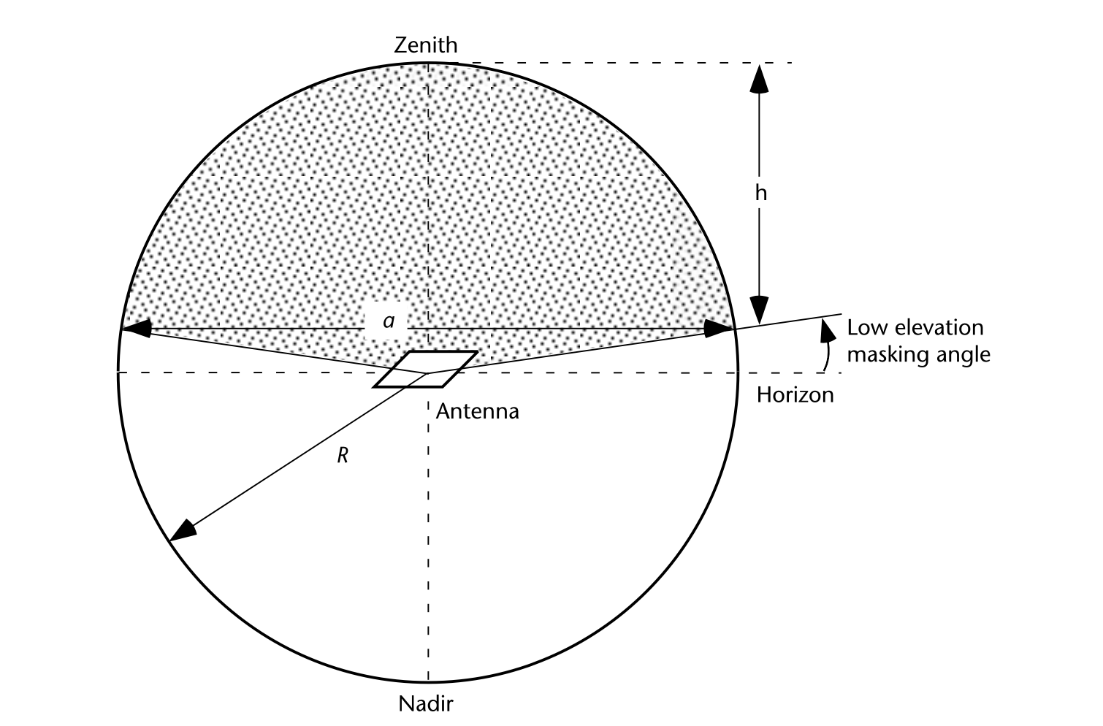
Ideal GNSS antenna directivity
Radiation in the upper hemisphere
Radiation stops at masking angle to prevent multipath signals and other interference
5º masking angle permits 5 satellites 100% of the time and 7 satellites 80% of the time

Slide 4
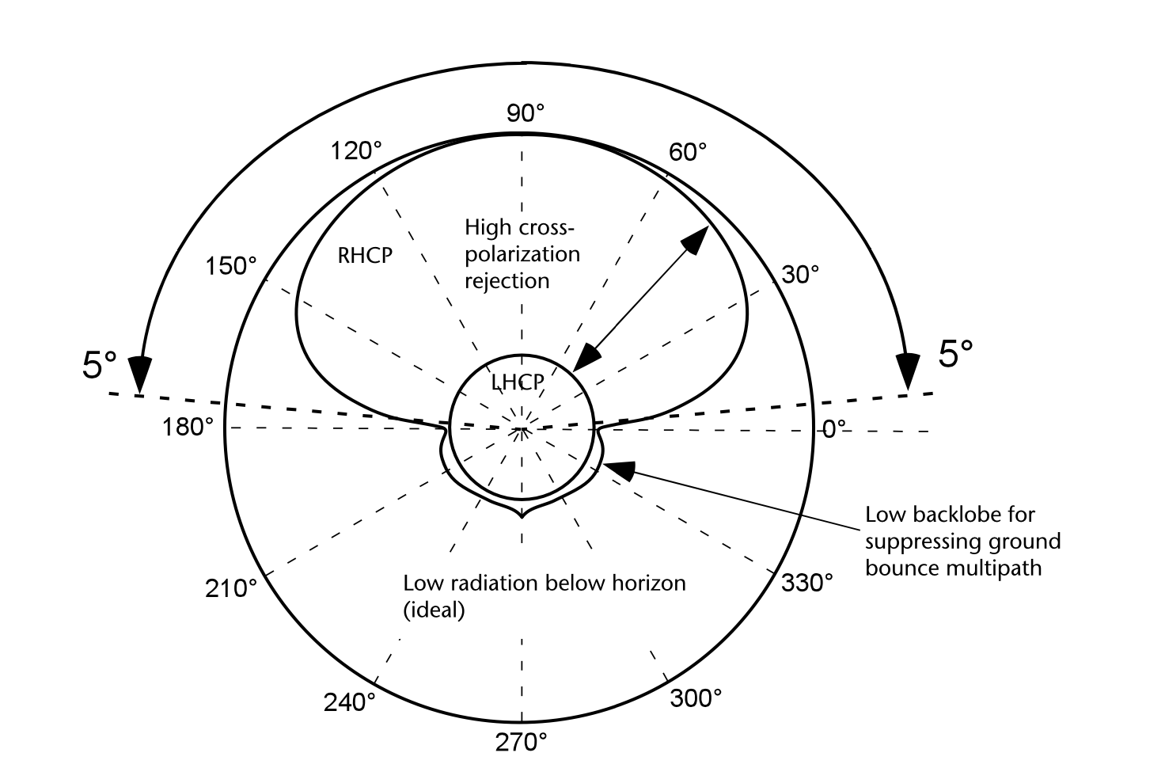
Ideal minimum gain beamwidth and polarisation
The minimum gain antenna beamwidth provides the gain necessary for the antenna to acquire and track at least four satellites, providing the best geometrical dilution of precision (GDOP)
GDOP expresses the uncertainty of all parameters such as latitude, longi- tude, height, and the clock offset

Slide 5
Accuracy of measurements
The accuracy of GNSS position in the horizontal direction, or HDOP is optimized when signals from low elevation satellites are acquired by the antenna and the line- of-sight vectors are evenly distributed in azimuth.
The position accuracy along the vertical (up) axis or VDOP is optimized when the antenna is able to acquire signals from the higher elevation satellites.
Parkinson [23] has shown that the best GDOP for 4 satellites is obtained when one satellite is over- head (i.e., at an elevation angle of 90° and azimuth angle of 0°) and the other three satellites are equally spaced at the minimum elevation of 5° and at azimuth angles of 0°, 120°, and 240°.

Slide 6
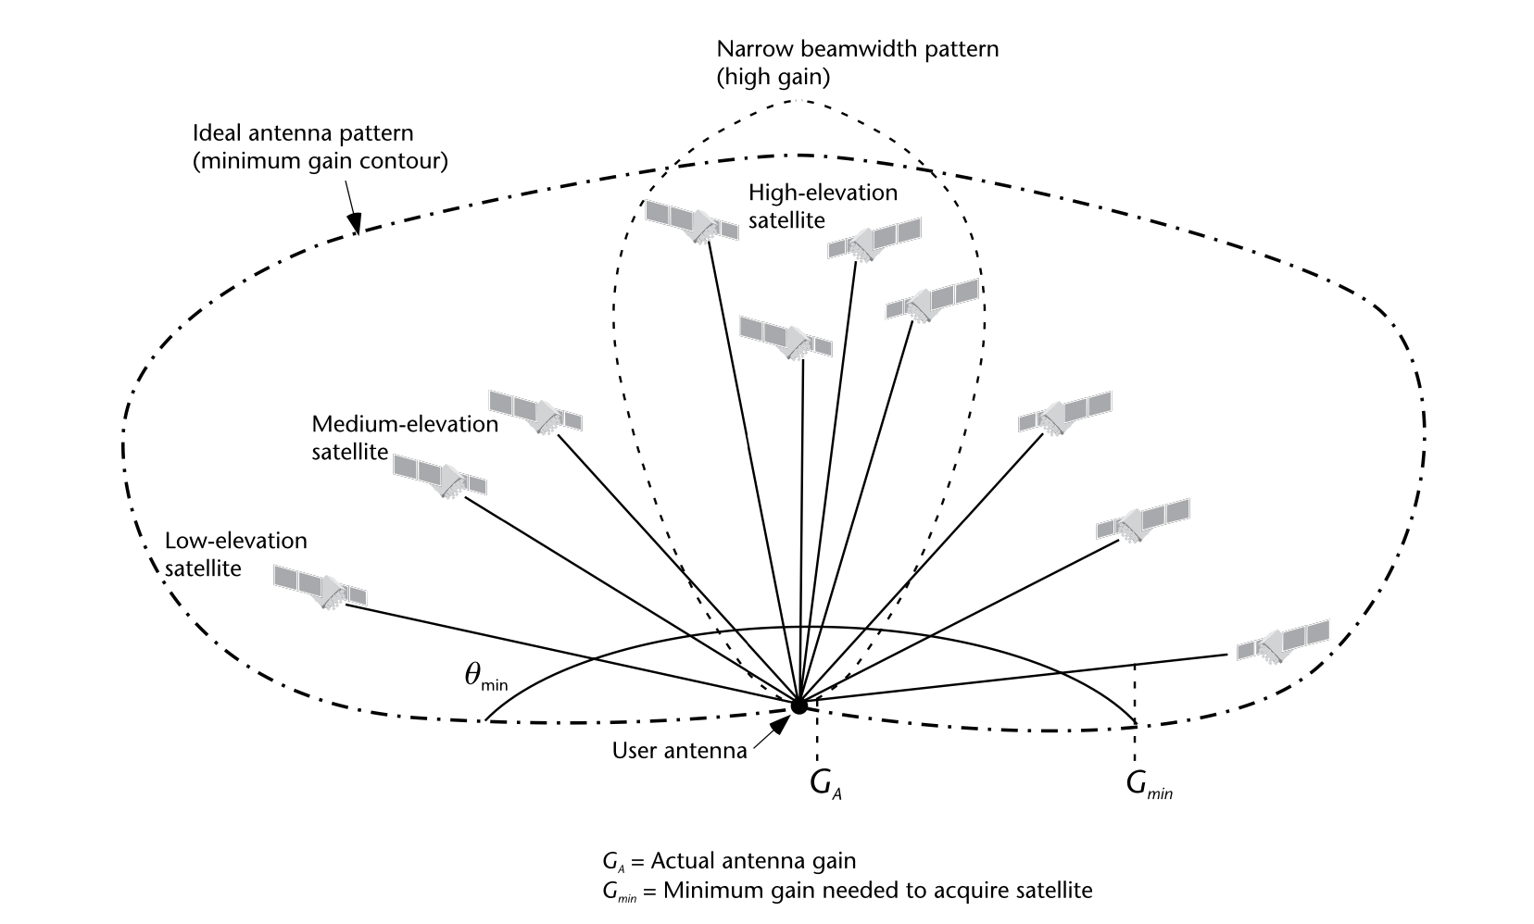
Combining antennas?
Narrow beamwidth can give good Vertical Dilution of Precision (VDOP)
Broader beamwidth can improve HDOP
Two GNSS systems could be used and replace the accelerometer

Slide 7
General antenna characteristics
Gain (dBic) - gain of circularly polarised antenna over isotropic antenna (Ublox - > 2 dBic
Voltage Standing Wave Ratio (VSWR) - measure of reflected signal on the antenna’s transmission line (1 is ideal, above 6 means more than 50% is reflected)
Phase center variation - where the signal hits the antenna; the lower the better
Return loss - incident power over reflected power; ideal is ∞ dB
Axial ratio - measure of deviation from circular polarisation; the ideal is 0 dB
Front-to-back ratio - radiation from front versus radiation from back

Slide 8
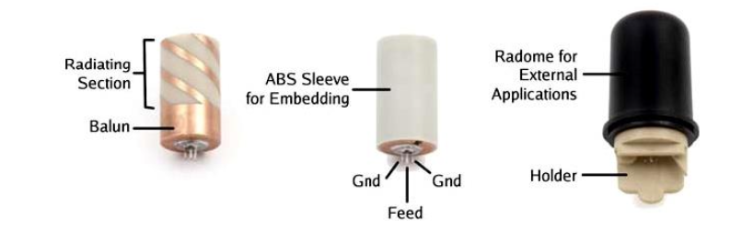
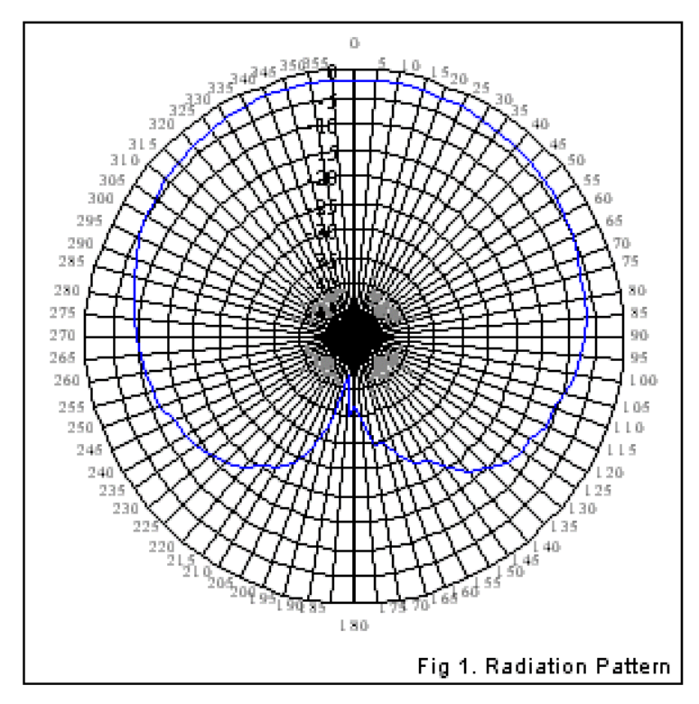
Helix antena
Approximately 18 mm x 10 mm
Ground plane not required
Can be more suited to tilting surface (e.g. a buoy)
Good back lobe
~9 dB axial ratio
Fairly narrow bandwidth
When used with a balun, front-to-back ratio can be poor

Slide 9
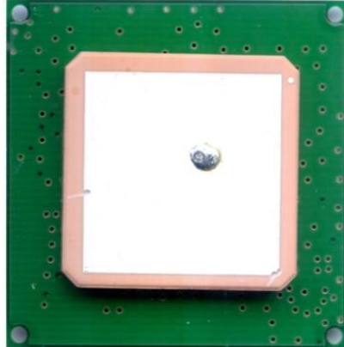
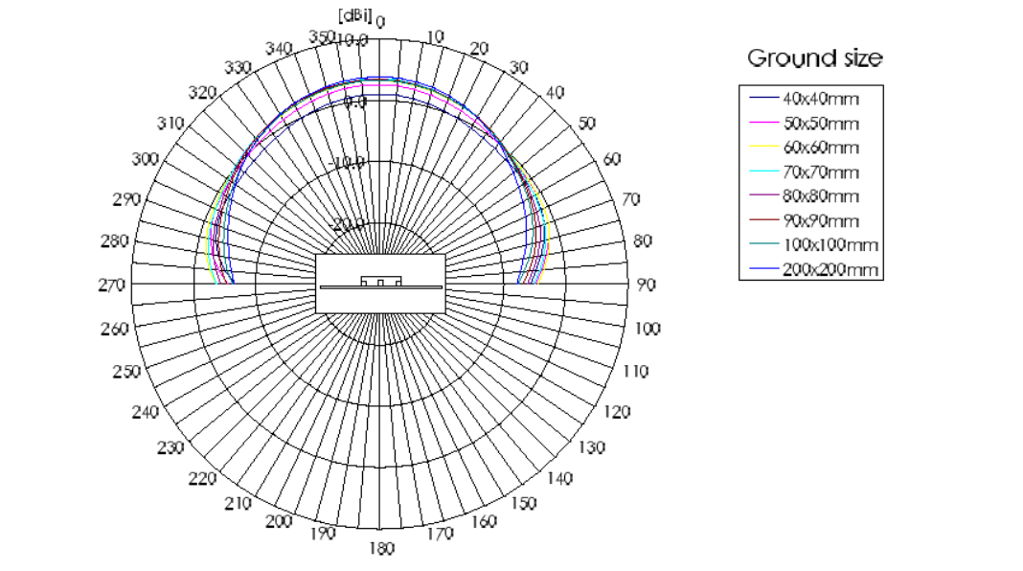
Patch antenna
25 mm x 25 mm
Large ground plane (70 mm x 70 mm) can result in better gain
Ideal for flat surface
Cheaper than helix antenna
Often have narrow bandwidth (2 MHz) just enough for civilian access (C/A) code
Upper hemisphere only
(lower hemisphere dependent on ground plane)

Slide 10
Decision
Due to the relative abundance of patch antennas on the market, it appears to be easier to find a patch antenna suits our needs.
It may be worth investing more to use helix antennas in future designs because of their broader beamwidth

Slide 11
Antenna requirements
According to Ublox, manufacturer of the receiver
High gain (> 4 dBic)
Low noise amplifier (LNA) with a low noise figure (< 2 dB)
LNA gain less than 26 dB to avoid saturation of signal
For active antenna, try to separate antenna gain (dBic) from LNA gain (dB)
25 mm x 25 mm Also, from literature:
Absolute minimum 2 MHz bandwidth for C/A code

Slide 12
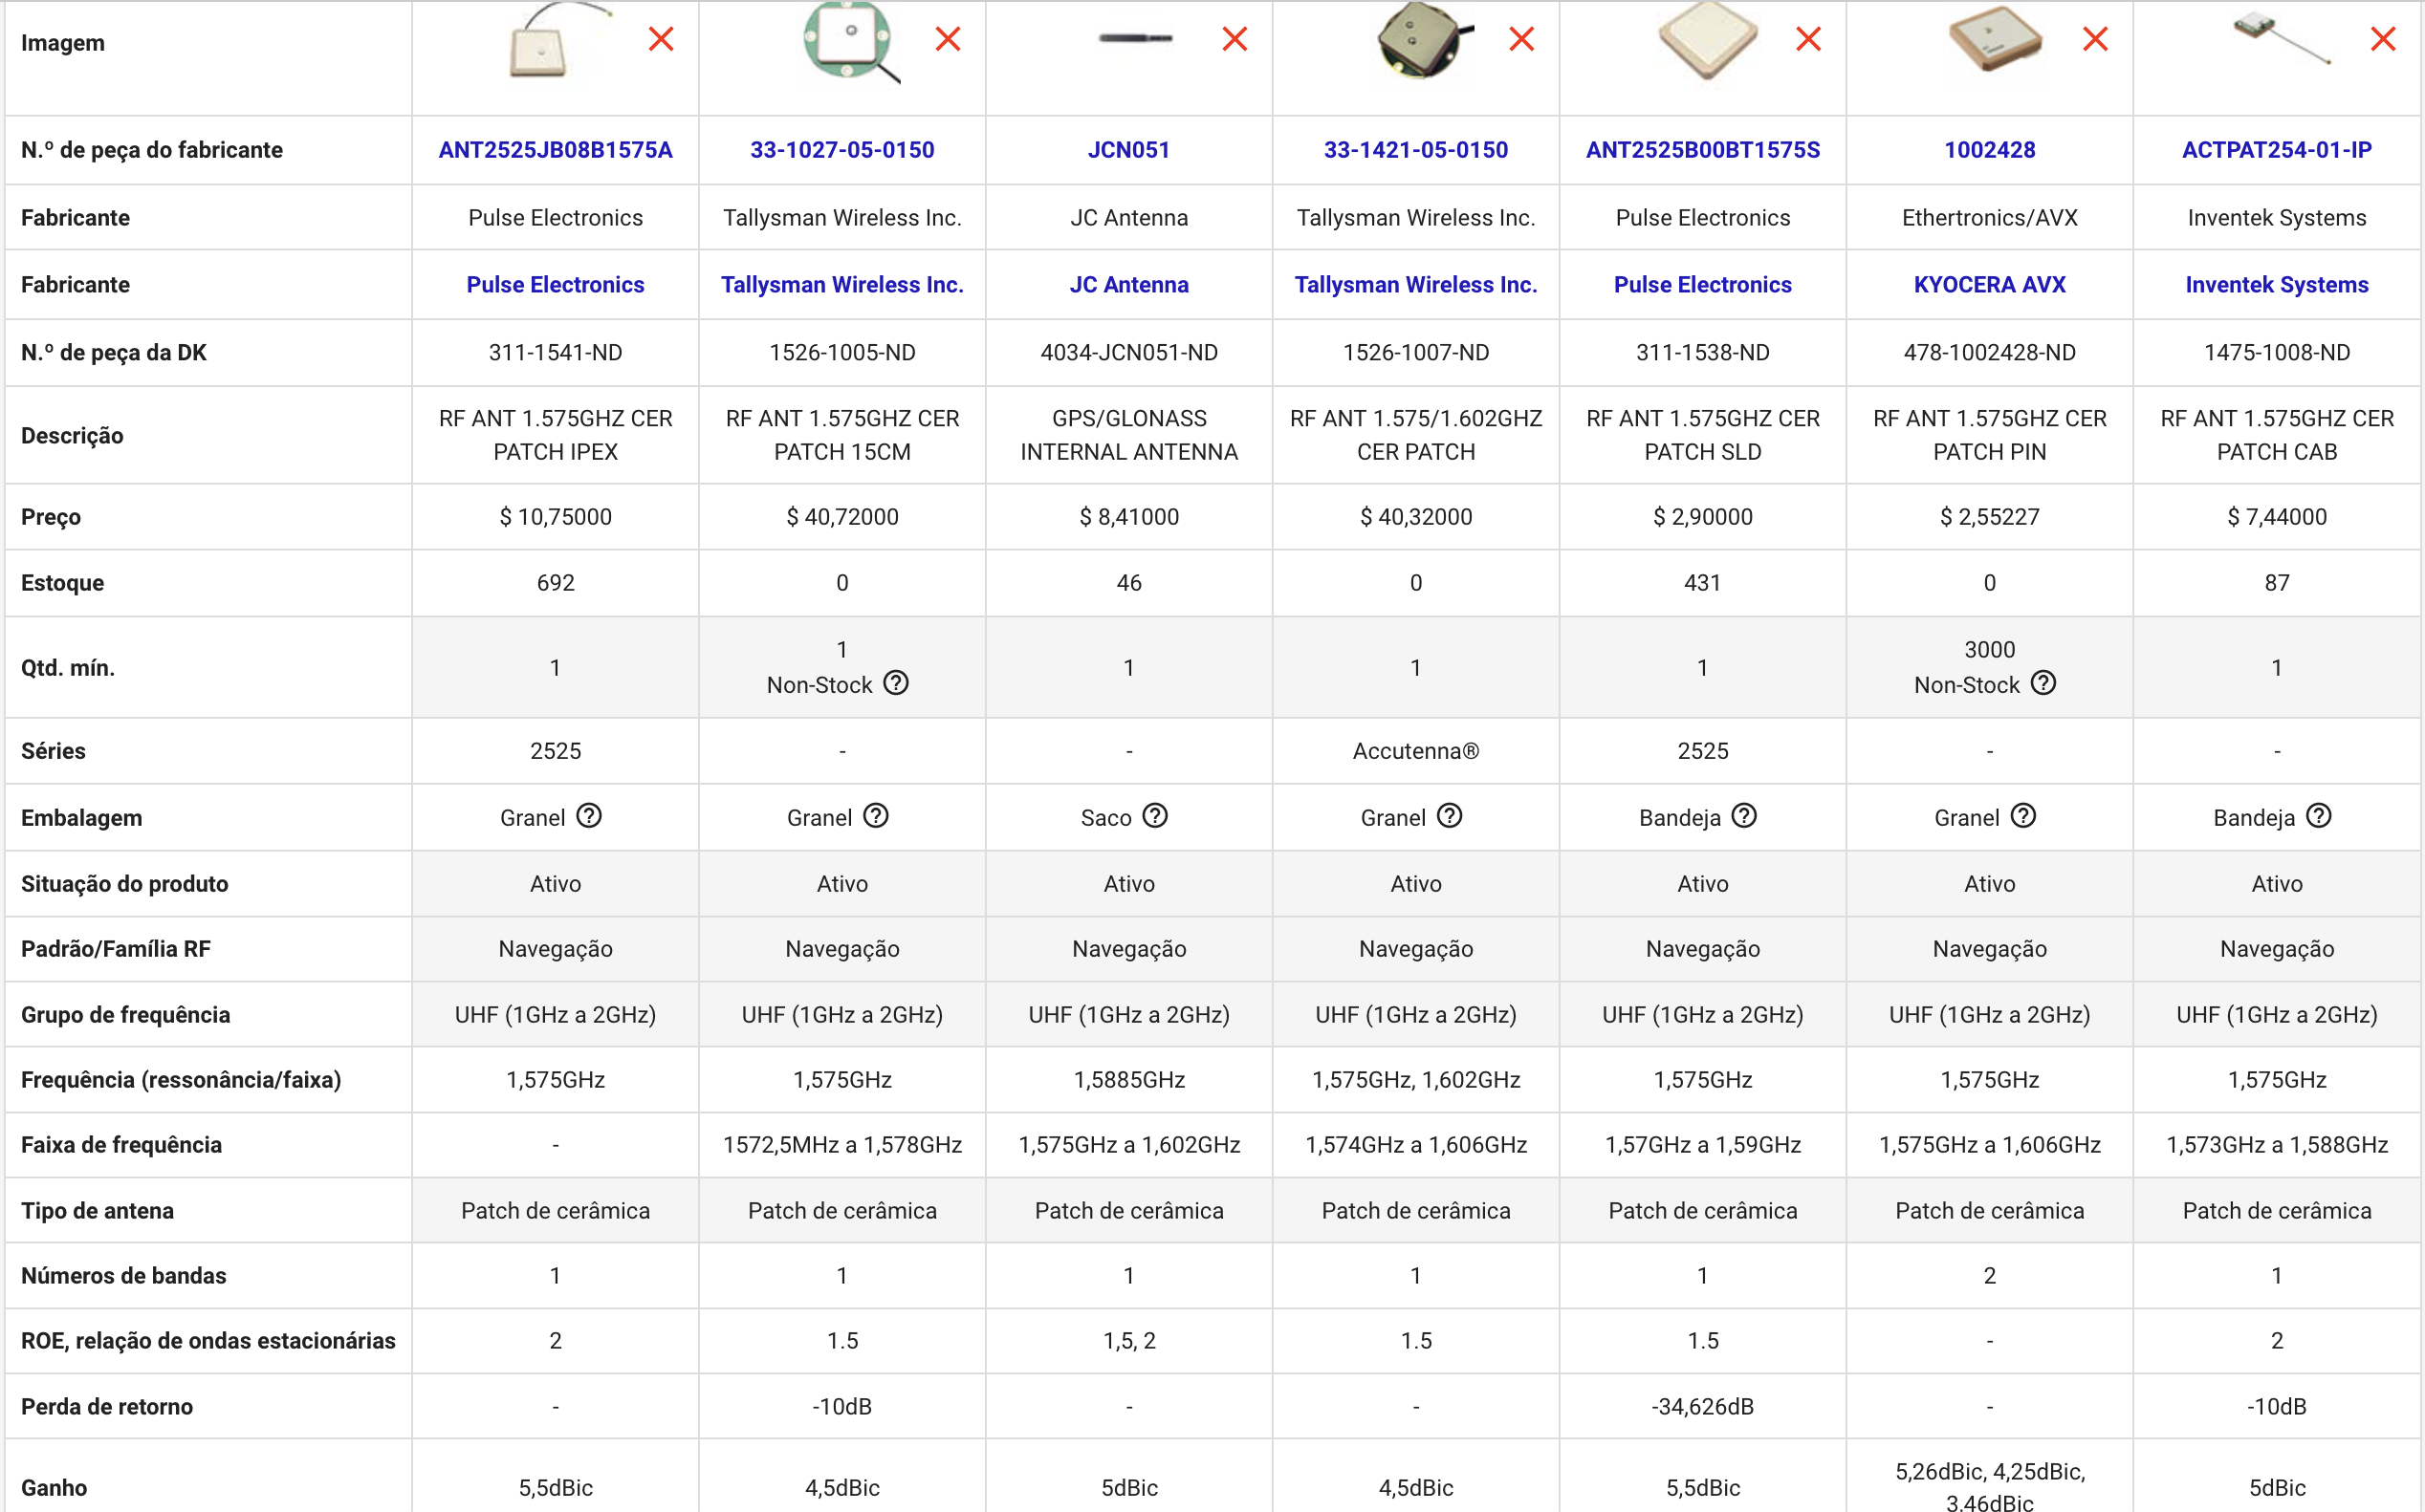

Slide 13
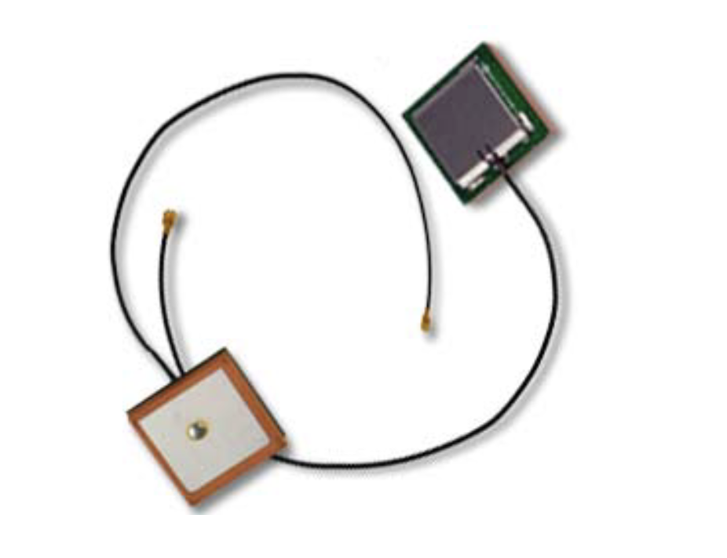
ACTPAT254 ACTIVE GPS ANTENNA

Slide 14
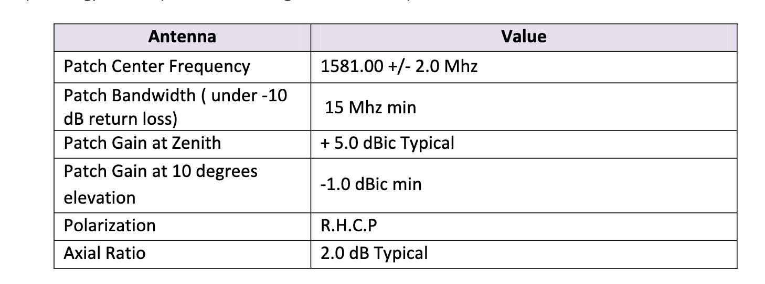
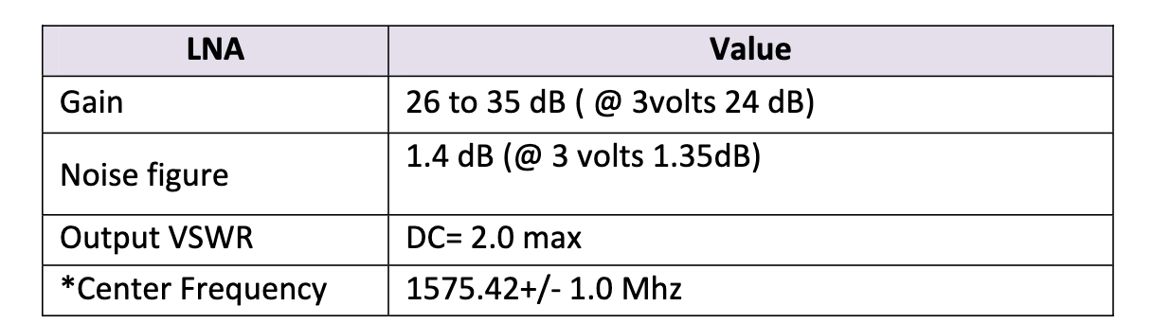
Characteristics

Slide 15
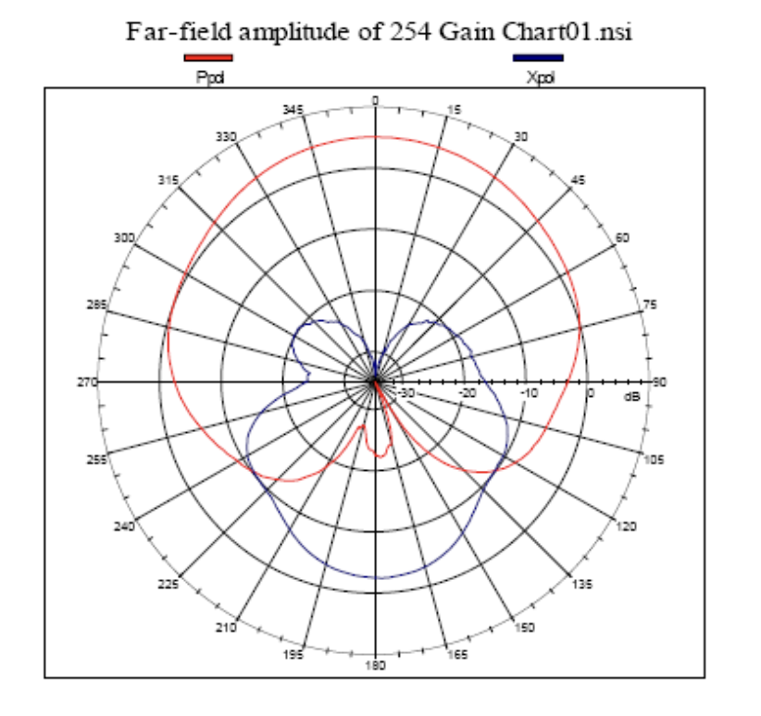
Diagrama de radiação

Slide 16
Design requirements (1)
According to Ublox, manufacturer of the receiver
Good match between antenna and cable impedance
Short connection between antenna and receiver
Visibility to the sky

Slide 17
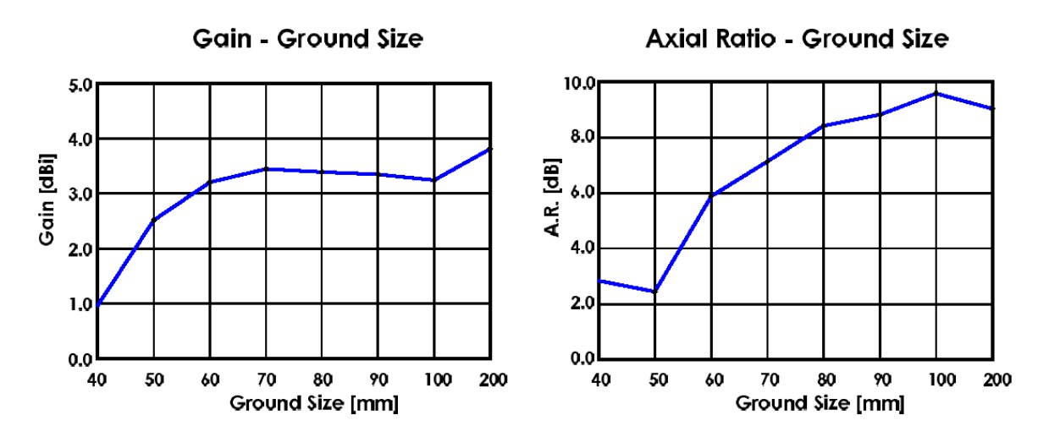
Design requirements (2)
Ground plane size
A good allowance for ground plane size is typically in the area of 50 x 50 to 70 x 70 mm².

Slide 18
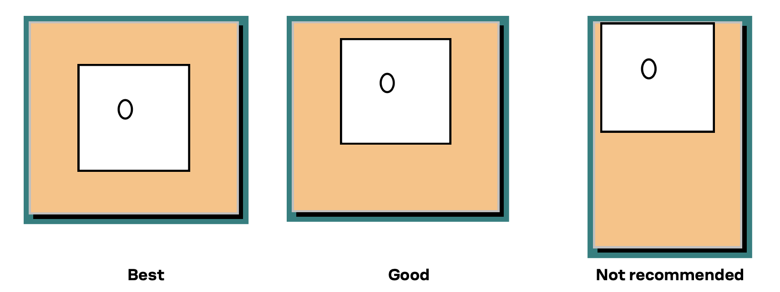
Design requirements (3)
Ground plane placement
No components should be placed close to the patch antenna
Maintain a minimum distance between the antenna and the housing of the device
No signal lines should pass under or near the antenna

Slide 19
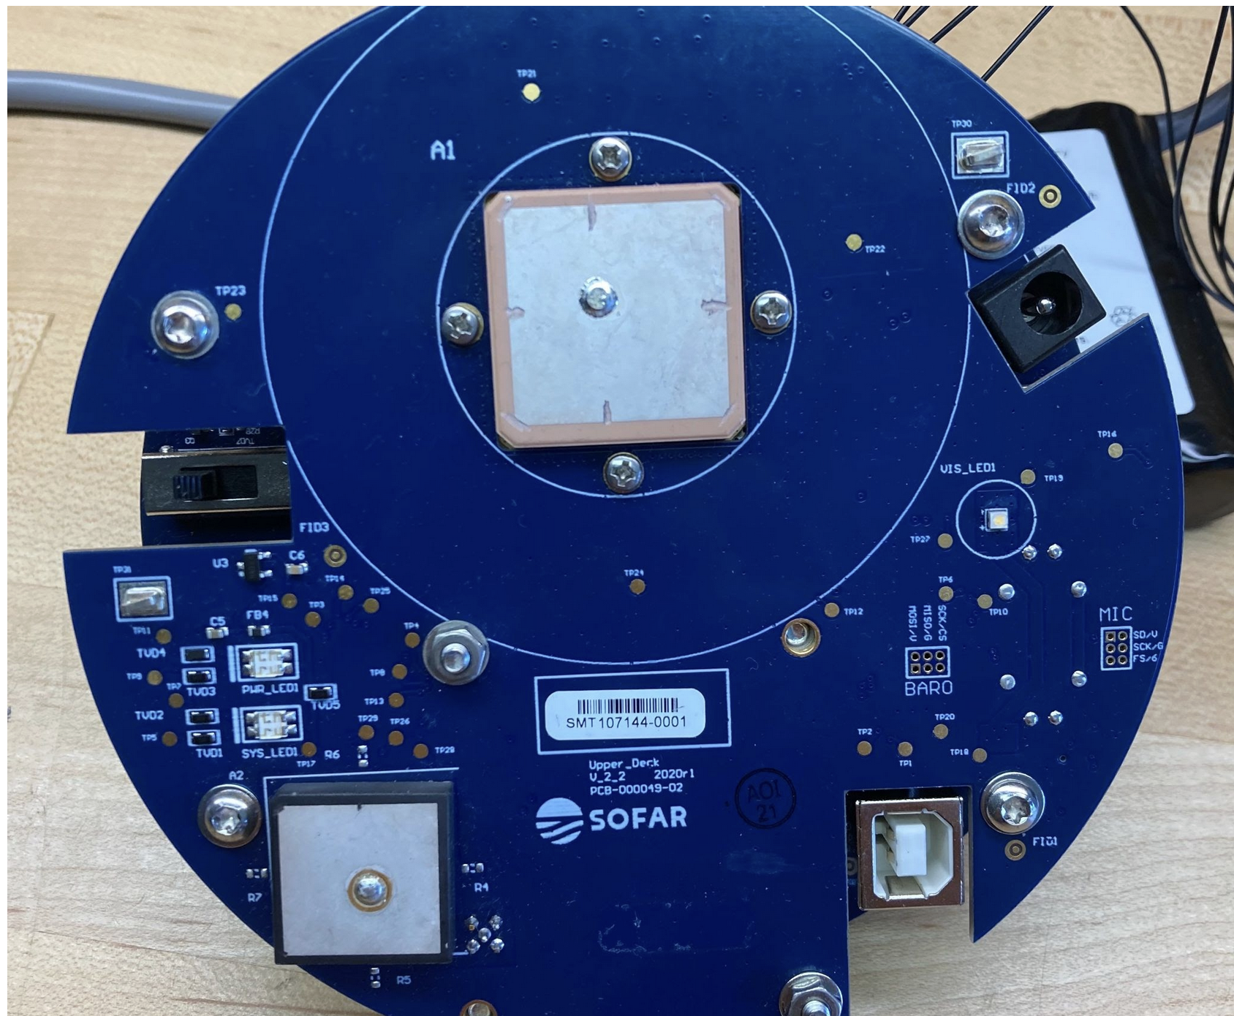
Design requirements (3)
Ground plane placement
Notice the size of the ground plane
on their circuit as well as the distance from other components

Slide 20
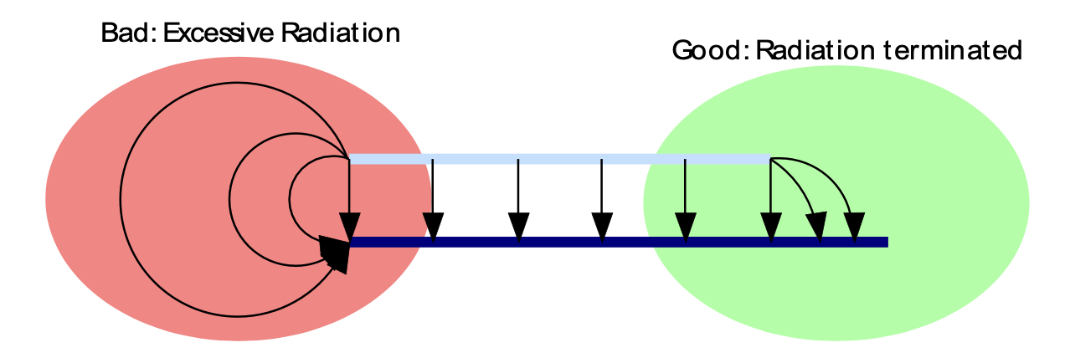
Design requirements (4)
Ground plane design
The outer extent of the power plane should be within the extent of the ground plane.
Have a ground frame on the circumference of every layer that is connected to the ground plane with as many vias as possible.

Slide 21
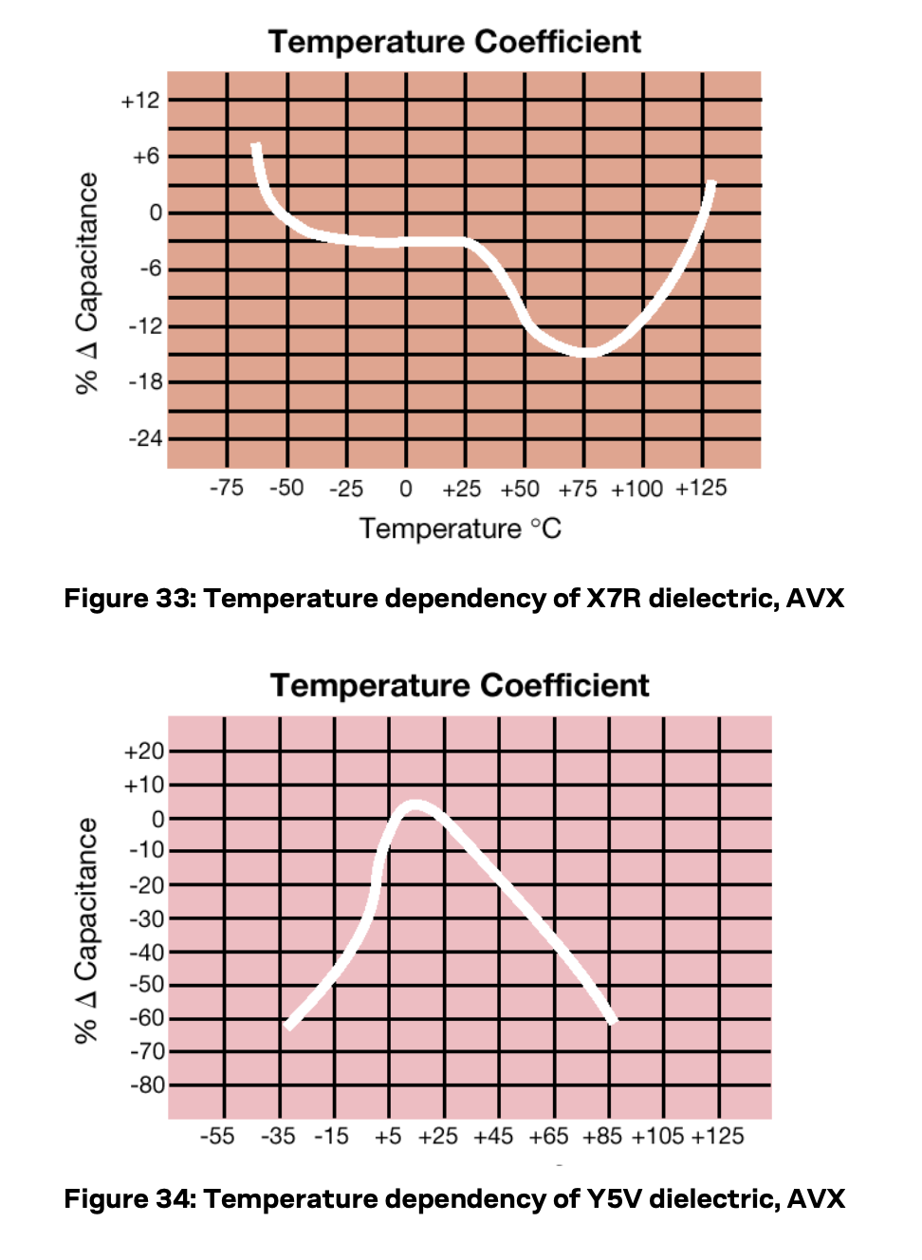
Design requirements (5)
Capacitors
At least a X5R quality should be selected
Y5V or Z5U types may lose almost all of their capacitance at extreme temperatures

Slide 22
Design requirements (6)
Voltage supply check
Voltage supply ripple must be below 50 mV p-p
Place LDO for GNSS close to the receiver
Use wide PCB traces or power planes
Ensure there are no inductors, resistors, fuses or diodes between LDO and GNSS

Slide 23
Design requirements (7)
Impedance matching
Centre frequency of antenna can shift away from GNSS frequency due to disturbances in near field
Can be caused by ground plane or by enclosure with dielectric constant different from the air
Receiver has internal DC block and 50 Ω impedance matching for GNSS so there is no need to add these components to RF path
Although we are using an active antenna, UBLOX says: “If the interconnect length between the antenna and LNA is much shorter than the wavelength (9.5 cm on FR-4), the matching losses become less important. “
As our transmission line from UF connector for matched and shielded antenna cable on PCB to receiver is short, perhaps we can trust this
The SAW filter has input and output impedances of 50 Ω so the losses are minimal and there should be no phase distortion

Slide 24
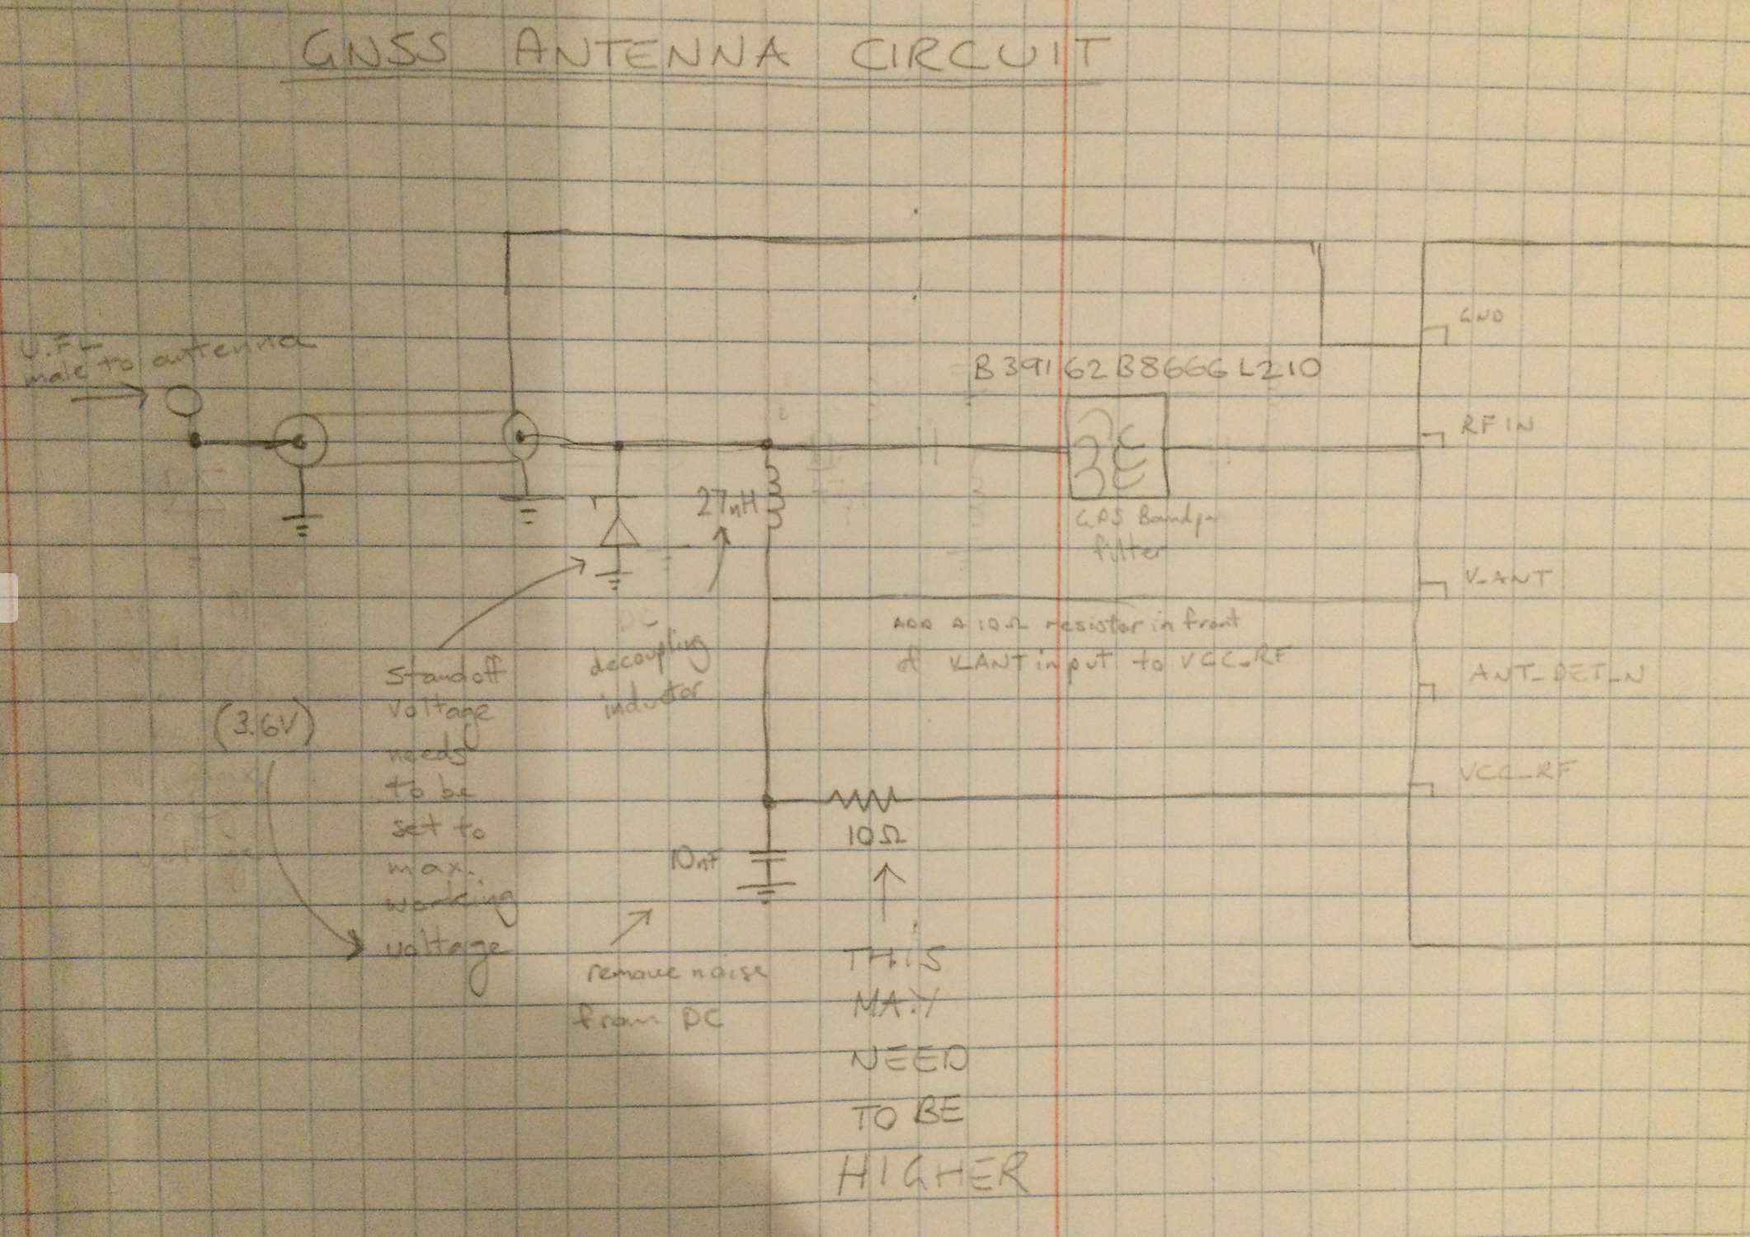
Initial Schematic (1)
Antenna
27 nH, impedance > 500 Ω at GNSS
frequency, rated current > 300 mA
X7R 100 nF 10% 16 V
10 Ω 10% 0.25 W

Slide 25
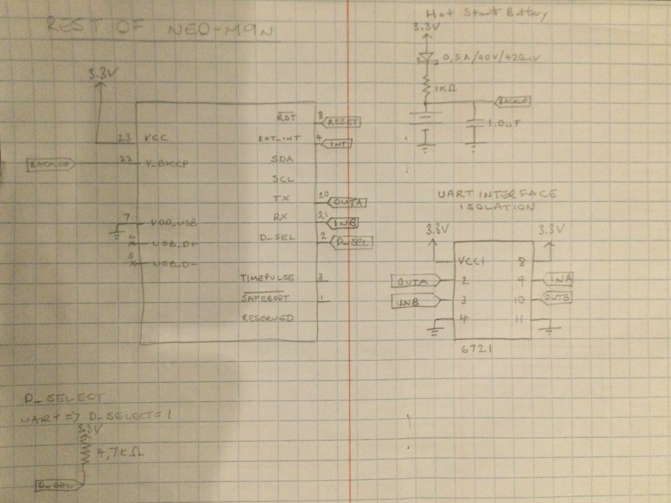
Initial Schematic (2)
Rest of circuit

Slide 26
References
NEO-M9N Integration manual https://content.u-blox.com/sites/default/files/NEO-M9N_Integrationmanual_UBX-19014286.pdf
GNSS Antennas AppNote https://content.u-blox.com/sites/default/files/products/documents/GNSS-Antennas_AppNote_%28UBX-15030289%29.pdf
GPS/GNSS Antennas, B Rama Bao et al (2013)
NEO-M9N-00B DataSheet https://content.u-blox.com/sites/default/files/NEO-M9N-00B_DataSheet_UBX-19014285.pdf

